Slide 1

LORAX- Train management system
MD. ZUHAIR
NARESH KUMAR
SHAAN KUMAR

Slide 2
OBJECTIVE
We built an web application, where passengers can sign-up and then login to book tickets by setting the destination of the passenger and where the passenger will be taking the train. This web app was made to simplify the ticket booking process.

Slide 3
MOTIVATION
The motivation of making this train e-ticket booking was that, people can easily book tickets online in a really straight forward way. The ticket booking system we made, is really easy to use and handle, and is really a user friendly one.

Slide 4
METHODOLOGY
For the database part, we used MY-SQL to store the passenger info,train info, etc.
For the backend part we used Django 2.2.7.
We used Python3 to do coding part of Django.

Slide 5
CHARACTERISTICS AND FUNCTIONS
We have provided a sign-up and log-in feature
Easy to book tickets in the project.
Easy to search for trains and their routes, and what is the departure time,etc.

Slide 6
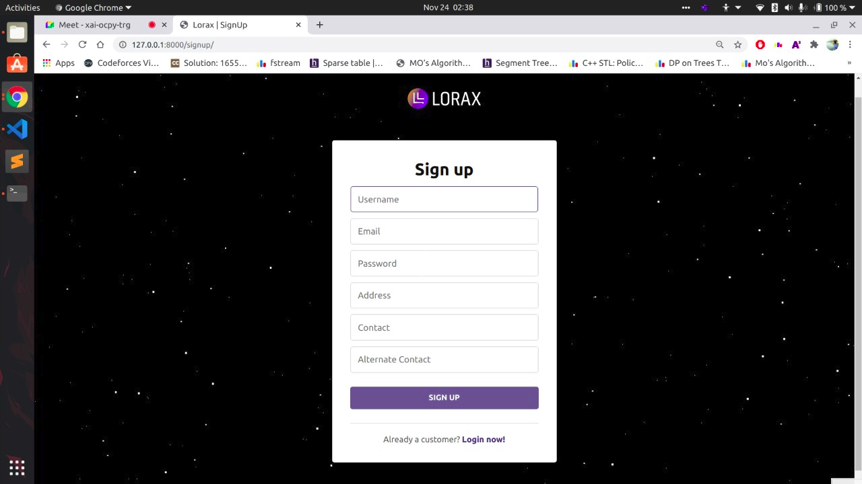
Sign Up PAGE

Slide 7
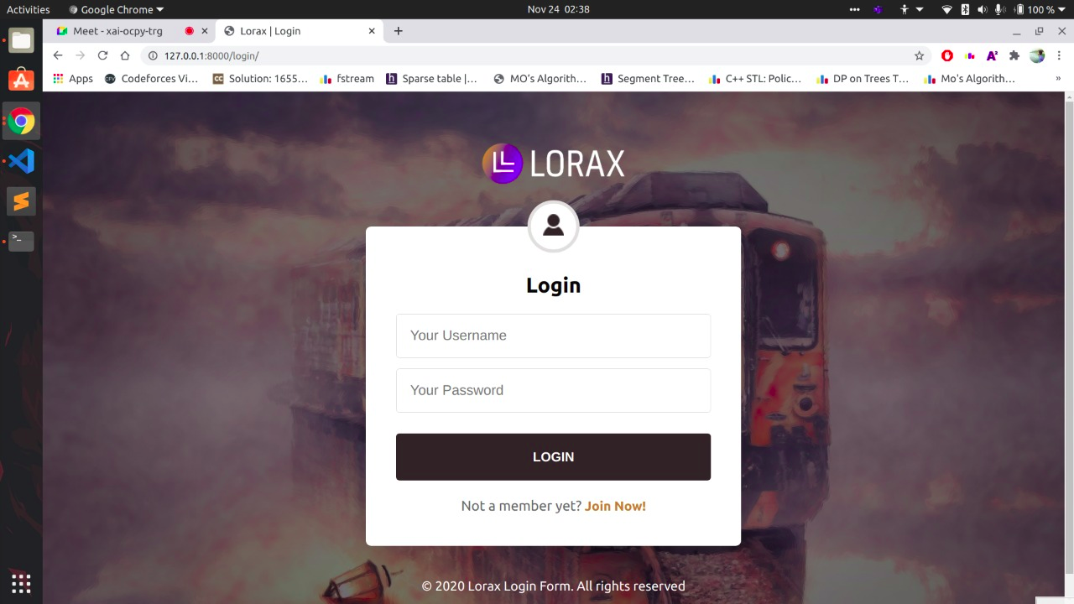
Sign In Page

Slide 8
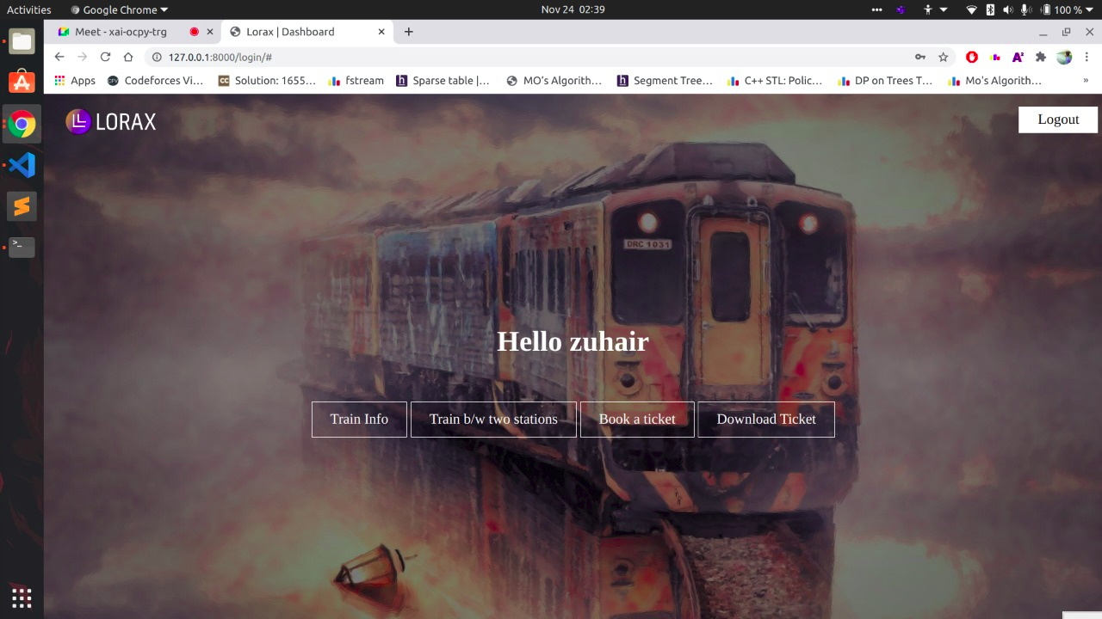
Dashboard

Slide 9
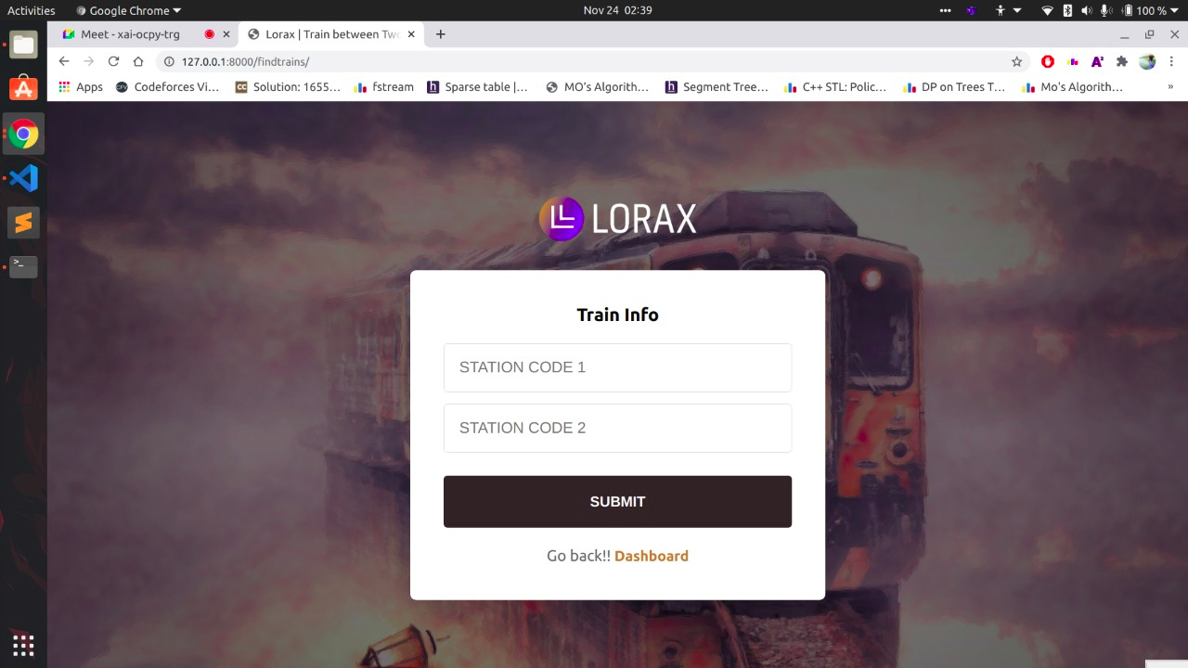
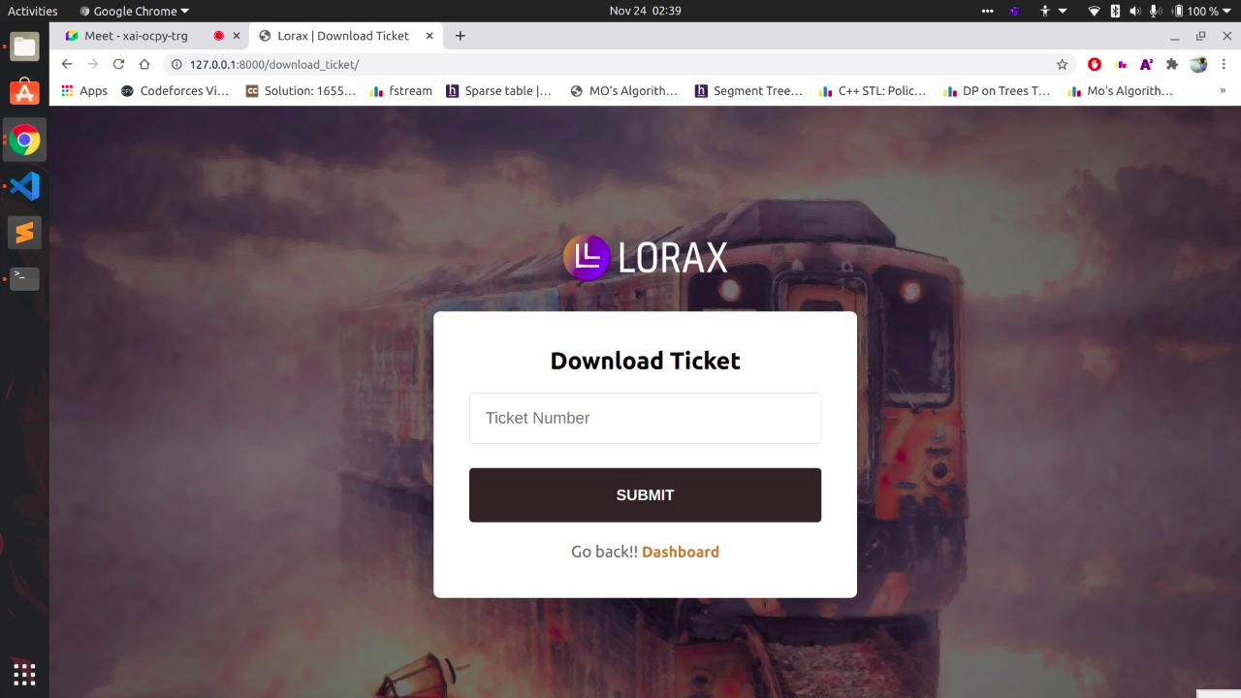
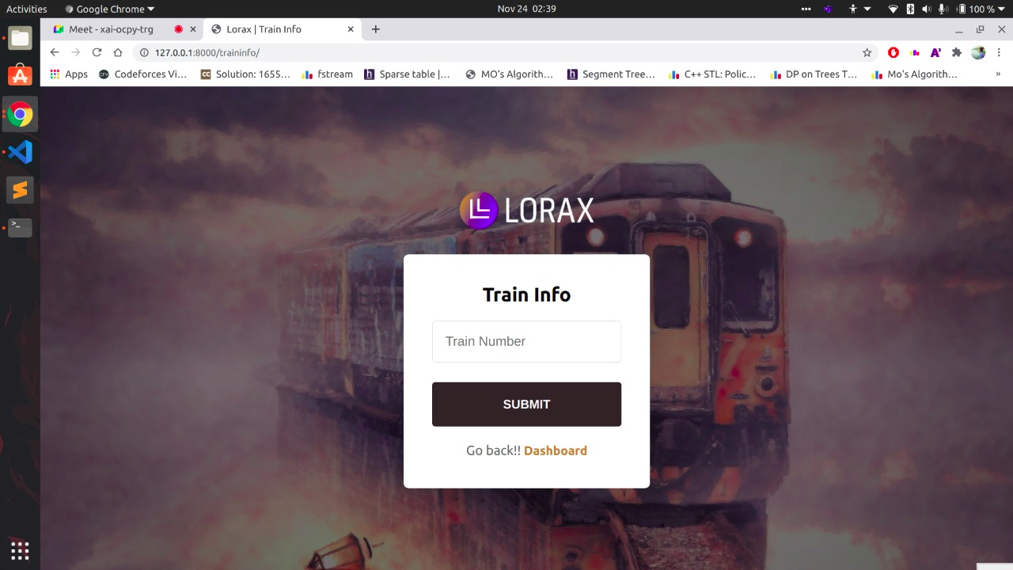
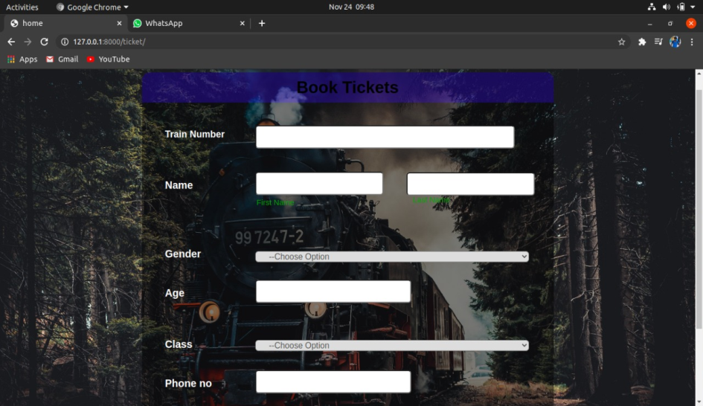
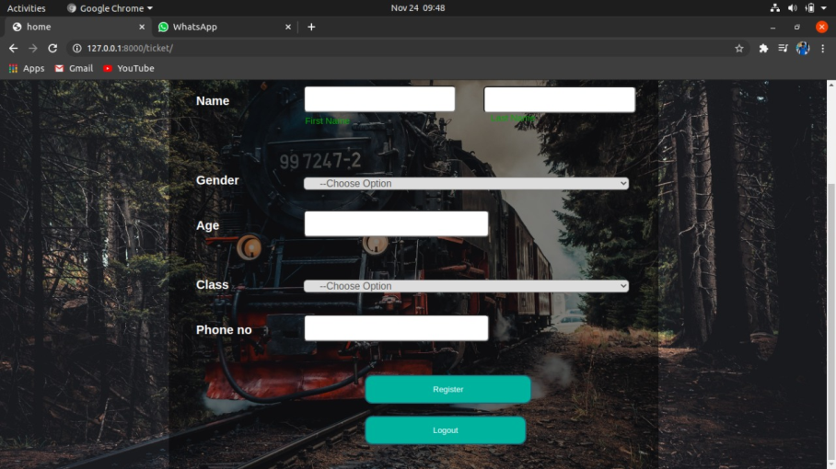
Features

Slide 10
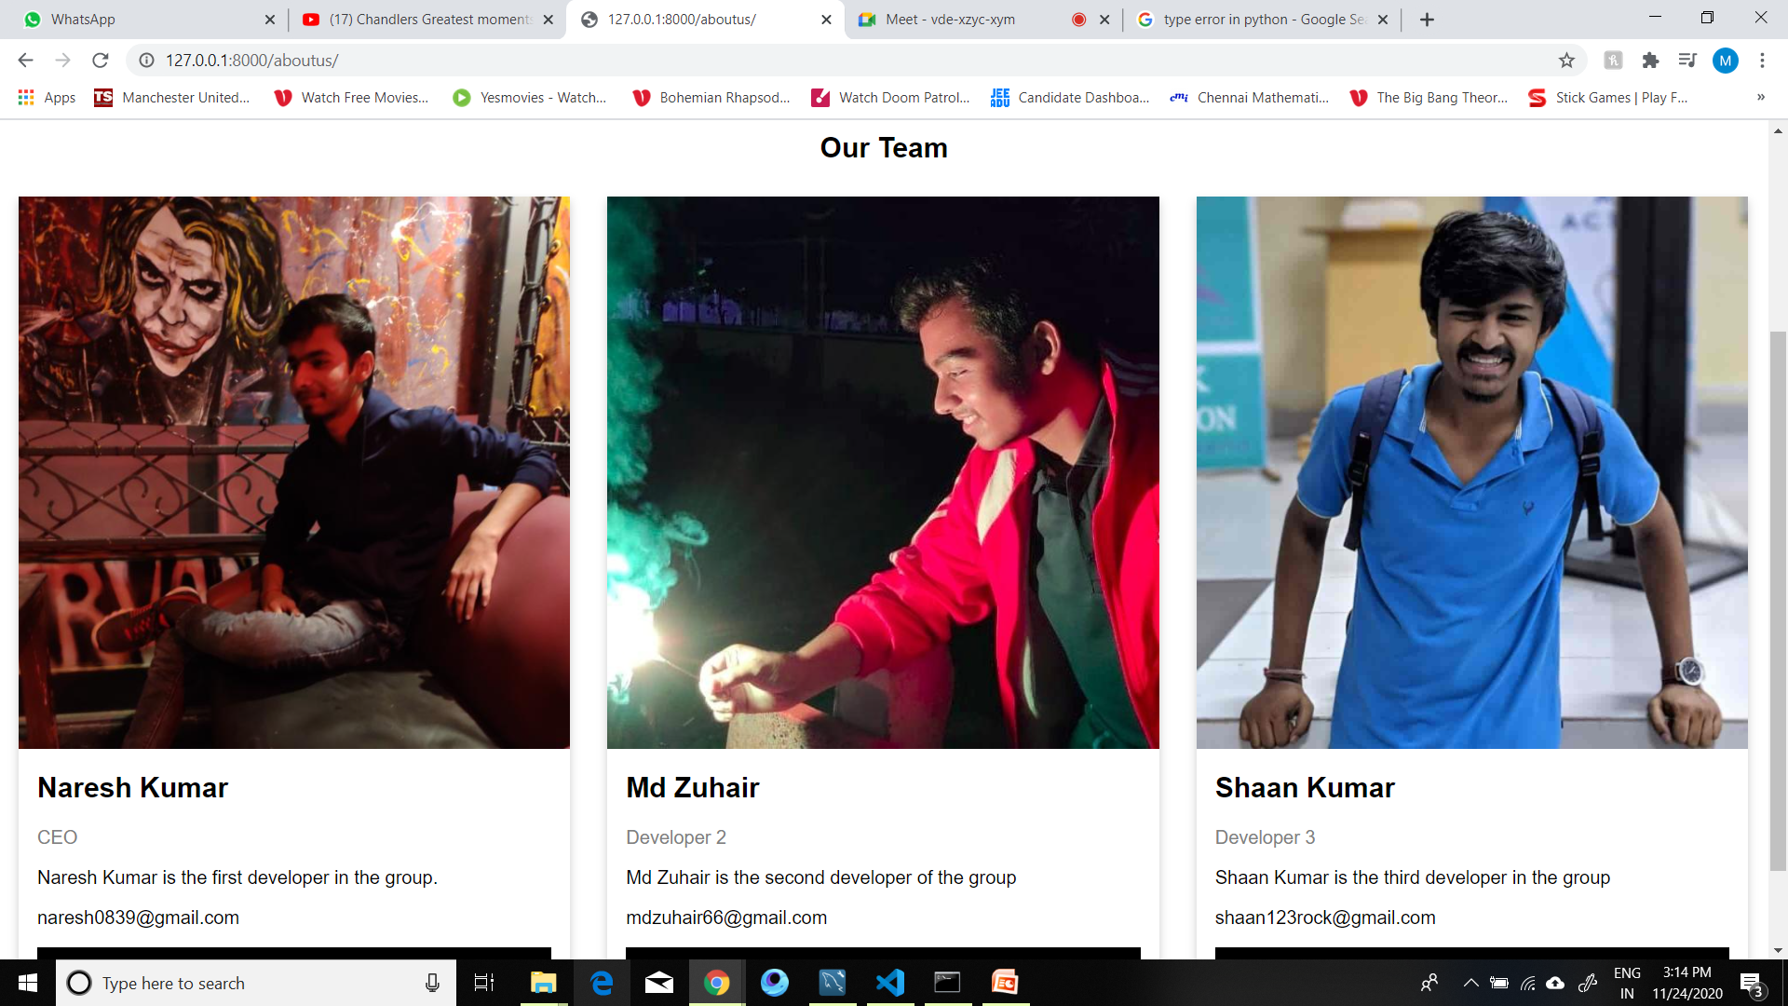
About us-

